Slide 1

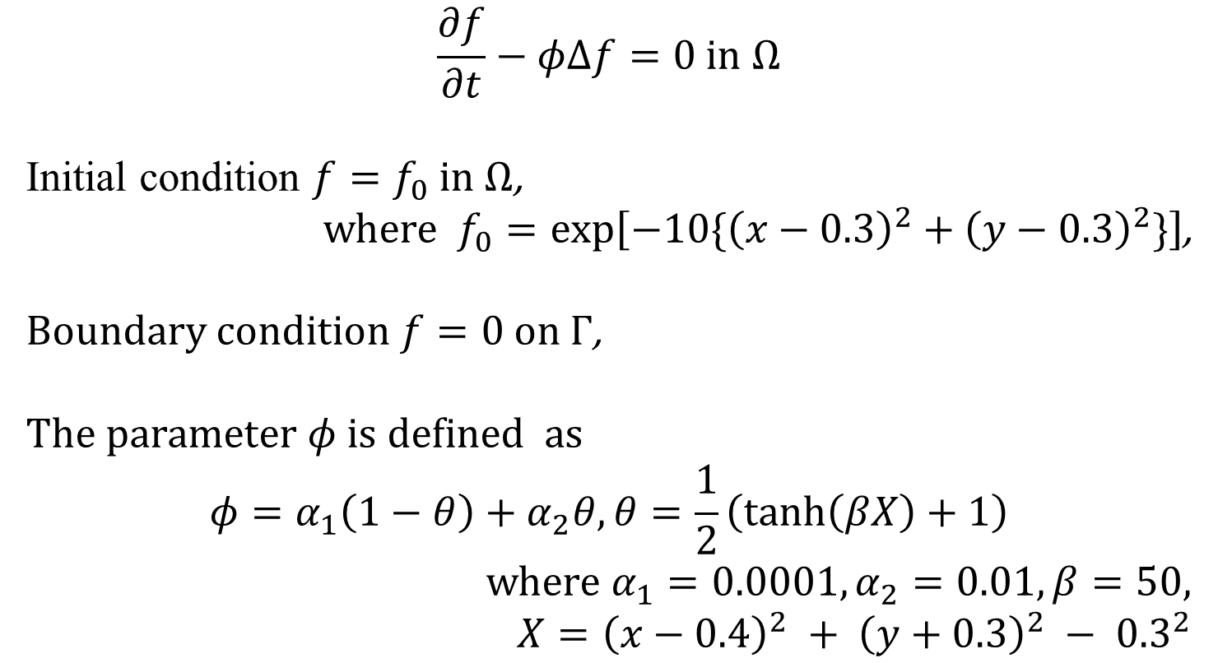

Problem15
$$Γ$$
$$Ω⊂R^{2}$$
$$\frac{∂f}{∂t}−φΔf=0 in Ω$$
Initial condition $f=f_{0} in Ω$,
where $f_{0}=\exp\left[−10\{{\left(x−0.3\right)}^{2}+{\left(y−0.3\right)}^{2}\}\right]$,
Boundary condition $f=0 on Γ$,
The parameter $φ$ is defined as
$$φ=α_{1}\left(1−θ\right)+α_{2}θ,θ=\frac{1}{2}\left(\tanh\left(βX\right)+1\right)$$
where $α_{1}=0.0001,α_{2}=0.01,β=50$, $X={\left(x−0.4\right)}^{2} + {\left(y+0.3\right)}^{2} − {0.3}^{2}$

